Slide 1
Europe 1973 –1992

Slide 2
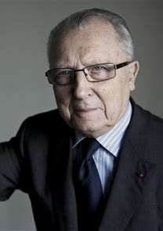
This period in the history of the European Union, especially under the Commission of Jacques Delors from 1985, is considered to have been one of the most productive. Delors presided over the accession of Spain and Portugal, the fall of Communism with the reunification of Germany in 1990, the adoption of the European flag, Single European Act 1986, Erasmus 1987, Schengen Agreement 1990, Maastricht Treaty 1992, the beginnings of EMU and the completion of the single market.
Paquet Delors
Reforms to the budgetary system of the EEC. Delors proposed changes to the budgetary process and to fund distribution. Establishes: the European Bank for Reconstruction and the Committee of the Regions. The system benefits poorer member states.

Slide 3
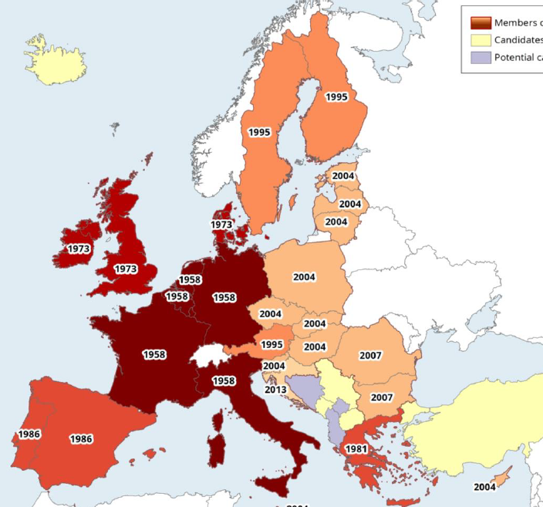
The extent of enlargement since 1973
Seven processes of enlargement: 1973: United Kingdom, Ireland and Denmark. 1981: Greece. 1986: Spain and Portugal. 1995: Austria, Finland and Sweden. 2004: Estonia, Latvia, Lithuania, Poland, Slovenia, Slovakia, Czech Republic, Hungary, Malta and Cyprus, 2007: Bulgaria and Rumania. 2013: Croatia.
2020: BREXIT

Slide 4
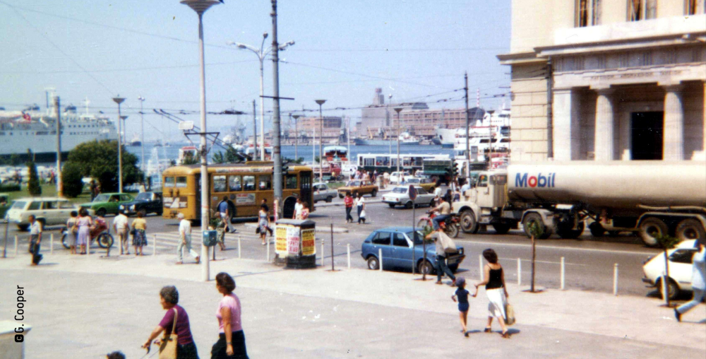
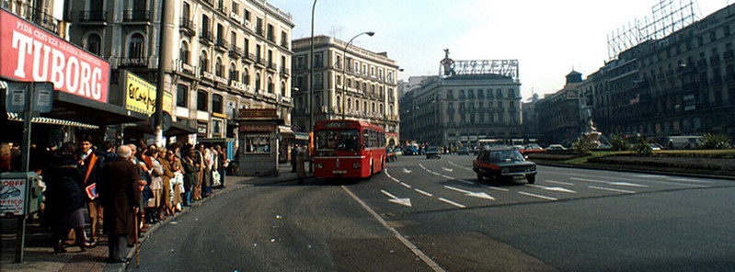
Focus…
In the 1980s the focus of enlargement was on the countries of southern Europe which were in the process of consolidating their democratic credentials. As we seen, the prospect of EEC membership was a central motivation for all involved. From the point of view of member states it was hoped among the accession of Spain, Portugal and Greece would be the best security against a relapse into dictatorship. The negotiations were long and not without significant opposition. Spain, Portugal and Greece, as poorer members of the Community, were all likely to draw heavily on the Community's Social and Regional Funds. France and Italy were concerned about competition from cheap Spanish farm produce. The Common Fisheries Policy opened up the prospect of intense competition from the Spanish fishing fleet, which was almost as large as the other members' fleets combined. There was also concern over competition from the low-wage Spanish and Portuguese economies, and their large steel and textile industries, areas in which there was already overcapacity in the Community.

Slide 5
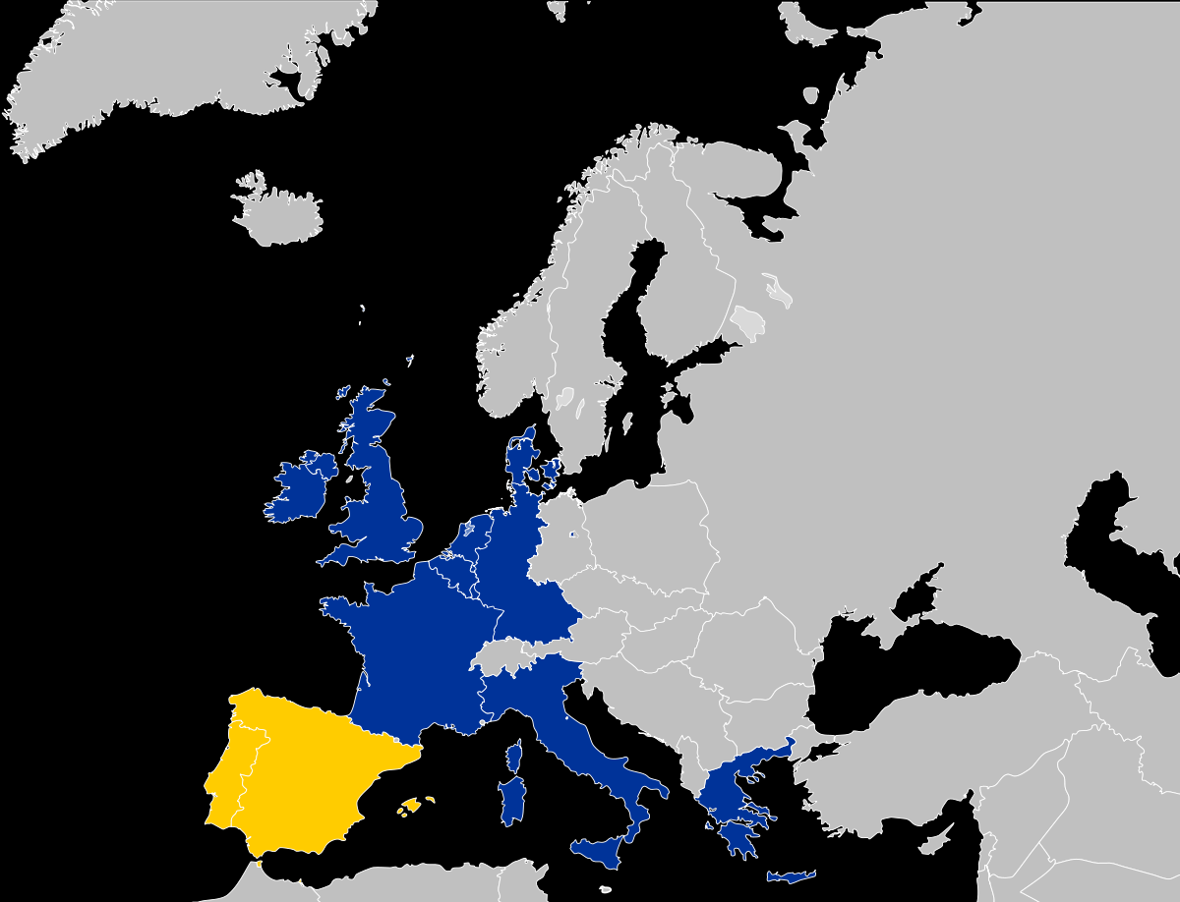
The situation of the Economy
But by 1986, twelve member states of the Community now contained 345 million out of a European population (excluding the USSR) of 500 million. These numbers alone explain the main motivation for both the enlargement and integration of the individual EU nation states. Europe’s economic competitiveness was falling behind the world leaders and radical change was needed if Europe was to remain a global force. The twelve now accounted for almost 20 per cent of the world's Gross National Product, just behind the American share but double that of Japan.

Slide 6
Other Applicants…
Community membership was still an attractive prospect for many countries. Turkey applied for membership in 1987. A decision was deferred in 1990, because of concerns as to whether Turkey met the relevant political and economic criteria for membership. Malta and Cyprus applied for membership in 1990. Austria had long been debarred from membership by its neutral status, but applied in July 1989, principally because two-thirds of its trade was with Community members. Norway reapplied for membership in 1992, but another referendum voted against joining. Sweden had rejected membership in 1958 because of its traditional neutral status, because it had reservations about the Common Agricultural Policy, and because its taxation and welfare systems were not in harmony with those of many Western European states. However, it applied for membership in 1991, followed by Finland.

Slide 7
Deepening integration Monetary Union
The Hague summit in 1969 agreed to aim for Economic and Monetary Union (EMU) by 1980, to be achieved in stages, but there were disagreements about the best route. Attempts at monetary cooperation, let alone integration, proved difficult.
In 1978 a limited European Monetary System (EMS) was agreed at the Bremen and Brussels Summits in 1978. The European Currency Unit (ECU) was introduced as a means for authorities in the Community to settle transactions between themselves. The Exchange Rate Mechanism (ERM) was also introduced: it allowed currencies to fluctuate up to 2.25 per cent either side of a central rate, before dropping out of the system. But this was all a long way off from economic union and a single currency.

Slide 8
A European Union
The Community made progress but also ran into difficulties as it moved into the late 1980s and the 1990s. One proposal not adopted was a draft treaty of European Union. The draft was approved by the European Parliament in February 1984 (Spinelli plan), and would have increased the powers of the Commission and the Parliament, thereby reducing those of the Council. The aim was to promote supranationalism over intergovernmentalism. It was rejected for this reason: national governments preferred to maintain their sovereignty.
A Single European Act however was signed by the foreign ministers in February 1986. Jacques Delors, president of the European Commission, summarised the main objectives of the Single European Act in the following way:
The Single Act means, in a few words, the commitment of implementing simultaneously the great market without frontiers, more economic and social cohesion, a European research and technology policy, the strengthening of the European Monetary System, the beginning of a European social area and significant actions on the environment

Slide 9
The Schengen Agreement
The Schengen Agreement is a treaty which led to the creation of Europe's Schengen Area, in which internal border checks have largely been abolished. It was signed on 14 June 1985, near the town of Schengen, Luxembourg, by five of the ten member states of the then European Economic Community. It proposed measures intended to gradually abolish border checks at the signatories' common borders, including reduced-speed vehicle checks which allowed vehicles to cross borders without stopping, allowing residents in border areas freedom to cross borders away from fixed checkpoints, and the harmonisation of visa policies.
In 1990, the Agreement was supplemented by the Schengen Convention which proposed the complete abolition of systematic internal border controls and a common visa policy. The Schengen Area operates very much like a single state for international travel purposes with external border controls for travellers entering and exiting the area, and common visas, but with no internal border controls. It currently consists of 26 European countries covering a population of over 400 million people and an area of 4,312,099 square kilometres.

Slide 10
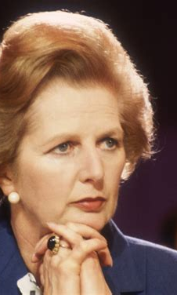
British Euroscepticism
In a celebrated speech, pronounced at the College of Europe in Bruges on 20 September 1988, Margaret Thatcher summed up her eurosceptic view:
To try to suppress nationhood and concentrate power at the centre of a European conglomerate would be highly damaging (...) We certainly do not need new regulations which raise the cost of employment and make Europe's labour market less flexible and less competitive with overseas suppliers (...) And certainly we in Britain would fight attempts to introduce collectivism and corporatism at the European level - although what people wish to do in their own countries is a matter for them.

Slide 11
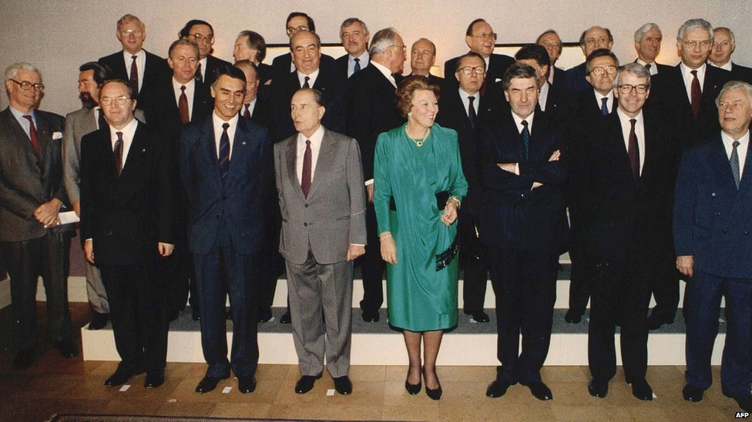
The Single Market and Treaty of Maastricht
The break-up of Communist regimes in the late 1990s, leading to the reunification of Germany and the break-up of the USSR, created new challenges for the Community. There was also the Gulf War, which required a united political response. Despite these differences, Community members signed the Treaty of European Union (TEU) at Maastricht in December 1991.

Slide 12
The Treaty stated that the new Community would build on existing treaties and that the ultimate objective was economic and monetary union. Foreign policy, defence, justice and home affairs would remain the preserve of member states. British reservations won the British government an 'opt out' clause, enabling it to determine when it would join the third stage of economic and monetary union. Britain also refused to sign the Social Protocol, by which eleven Community members committed themselves to promoting employment and better living and working conditions. Maastricht also led to institutional reforms. Qualified majority voting in the Council and Parliament's powers were extended. Parliament was empowered to set up committees of enquiry. A Regional Committee was set up, enabling regional representatives to participate in decision making. A Cohesion Fund was to progress environmental and transport projects in less developed areas. The concept of common citizenship was emphasised. Finally, the principle of subsidiarity was adopted: this meant that policy decisions should be taken at the appropriate level. Britain interpreted this as offering a means by which the powers of the European Commission could be restricted.

Slide 13
The Maastricht Treaty turned the Economic Community into the European Union (EU). However, the Treaty did not come into effect until November 1993, eleven months late, because several states had difficulty in ratifying it. Referenda were held in three member states. There was increasing talk of a 'multi-speed Europe' in which some member states would progress towards integration at a much faster rate than others.
The role of the European Parliament also changed as the Community matured. Early limitations on Parliament's powers reflected the fact that federalism had few prominent supporters. Most member states wanted cooperation to stay at the level of intergovernmental agreement and no further. In December 1990 there were intergovernmental conferences to consider political as well as economic and monetary union. But there were strong disagreements about the allocation of power between Parliament, the Council of Ministers and the Commission. At one extreme the Italian Government supported federalism, at the other Britain wanted to retain virtually full national sovereignty. In all member states there were large numbers of opponents as well as supporters of the idea of further integration of both institutions and policies.

Slide 14
Activities
1. Learn the dates and countries associated with the ‘seven processes of enlargement’.
2. Why was further enlargement from 1973 to 1992 a slow process that often faced significant opposition?
3. Thatcher and Delors personified two very different perspectives on the future of Europe, summarize these differences.
4. What steps were taken towards greater integration from 1973 to 1992? (Examples and dates are useful here) What opposition was faced and why?
5. Summarise the main features of the Maastricht Treaty.

Slide 15
Europe since Maastricht

Slide 16
Key events to the present day
1993 – Copenhagen criteria of accession defined. 1995 – Accession of Austria, Finland and Sweden. 1999 – Fraud in the Commission results in resignation. 2002 – The euro replaces twelve national currencies. 2004 – Accession of ten countries; signing of Constitution. 2005 – France and the Netherlands reject the Constitution. 2007 – Accession of Bulgaria and Romania. 2009 – Lisbon Treaty. 2013 – Accession of Croatia. 2020 – Brexit
2022. Russian invasion of Ukraine. 2023. Gaza War/Genocide after October 7th

Slide 17
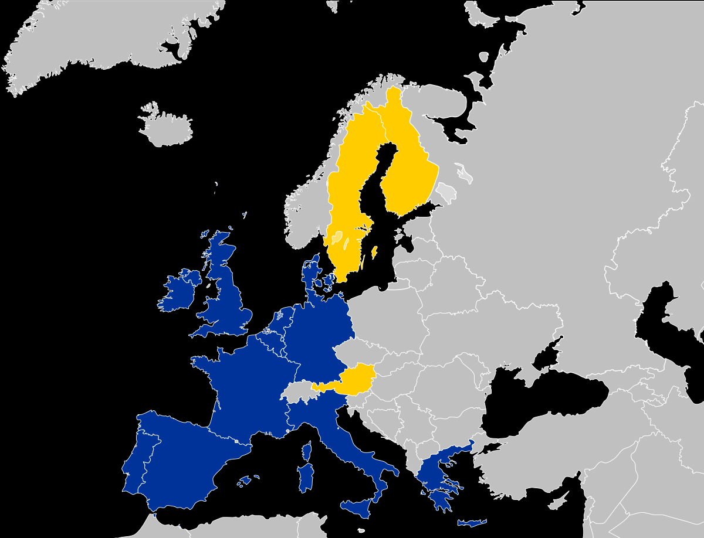
Further Enlargement
On the principle that it was best to be part of the decision-making process, Austria, Sweden and Finland all joined the Community in 1995. Norway did not join after another negative referendum vote. Apart from Iceland and Switzerland, which had bilateral agreements with the Community, Norway was the only Western European country still outside the European Union.

Slide 18
The Central and Eastern European states keen on membership of the EU faced a different challenge. Their economic development lagged behind that of existing member states, so their economies would have been too vulnerable for immediate exposure to Western European competition. Poland, the Czech and Slovak Republics, Hungary, Romania and Bulgaria were granted ten-year 'Europe Agreements' which allowed them some free trade with the EEC. In July 1997, it was agreed that Poland, Hungary, the Czech Republic, Slovenia, Estonia and Cyprus had achieved the necessary economic and political reforms (Copenhagen criteria) to allow negotiations to join the Union to begin in 1998. Latvia, Lithuania, Romania, Bulgaria and Slovakia were ruled out of membership on the grounds that they still had significant political or economic problems. All these problems were eventually addressed in time for the biggest single enlargement in 2004 and as second in 2007 which finally saw Romania and Bulgaria join. 2013 saw the accession of Croatia the 28th member of the Union.

Slide 19
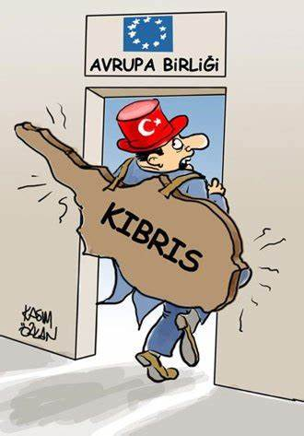
Candidate countries and the Turkish issue
After suffering in the recent banking crisis Iceland has made a formal application to join the EU. If disputes over fisheries are resolved and the Icelandic people vote positively in a referendum, then Iceland could join the Union relatively quickly. In an ongoing program of enlargement, there are five other candidates: Albania, Northern Macedonia, Montenegro, Serbia, and Turkey. Also within the enlargement agenda are the states of Bosnia-Herzegovina and Kosovo. Turkey's long-standing application for membership still has to be addressed. Turkey's dispute with Greece over Cyprus, an existing member of the Union, remains one of but not the only problem.

Slide 20
Further integration
Norway, Iceland and Liechtenstein joined the European Economic Area (which entered into force on 1 January 1994), an organisation that allowed European Free Trade Association states to enter the Single European Market. The following year, the Schengen Agreement came into force. The 1990s also saw the further development of the euro. 1 January 1994 saw the second stage of the Economic and Monetary Union of the European Union begin with the establishment of the European Monetary Institute and at the start of 1999 the euro as a currency was launched and the European Central Bank was established. On 1 January 2002, notes and coins were put into circulation, replacing the old currencies entirely. The European Defence Agency (EDA) was set up in 2004, it is a Common Foreign and Security Policy (CFSP) body reporting to the Council of the European Union. Its primary role is to foster European defence cooperation.

Slide 21
The Foreign Policy challenge
During the 1990s, conflicts in the Balkans gave impetus to developing the EU's Common Foreign and Security Policy (CFSP). The EU failed to react during the beginning of the conflict, and European UN peacekeepers failed to prevent the Srebrenica massacre (July 1995) in Bosnia and Herzegovina, the largest mass murder in Europe since the Second World War. The North Atlantic Treaty Organization (NATO) finally had to intervene in the war, forcing the combatants to the negotiation table. These events led to foreign policy being emphasised in the Treaty of Amsterdam 1999, which marked the beginning of a common European foreign and security policy (CFSP) and which created the High Representative. In 2013 the diplomatic role of Higher Representative developed significantly after the Lisbon Treaty with Catherine Ashton (2010-14) central to the agreement between Serbia and Kosovo that normalised their ties. Events in the Ukraine crisis (from 2013) put renewed pressure of the EU to be able to provide a collective military response.

Slide 22
Political crises, rising euroscepticism and a two track Europe?
The Parliament refused to approve the Commission's 1996 community's budget on grounds of financial mismanagement, fraud and nepotism. With Parliament ready to throw them out, the entire Santer Commission resigned. The post-Delors mood of euroscepticism wase reinforced with the Council and Parliament constantly challenging the Commission's position. In European Parliament elections in 2014, 25% of the votes were cast for eurosceptic parties. In Britain, France, Denmark and Greece, eurosceptic parties won the biggest number of seats. As much of a concern was the voter turnout of 43%, the lowest on record.

Slide 23
The Convention on the Future of Europe was established in 2002 to create an EU constitution, and the draft, signed in 2004, aimed to install a permanent EU president, a Foreign Minister and a Charter of Rights. It would have also allowed the EU to make many more decisions instead of the heads’ of the individual nation states. This would have been a significant step towards supranationalism, reducing the power of nation sates. It was rejected in 2005, when France and the Netherlands failed to ratify it. An amended work, the Lisbon Treaty of 2009 created the post of President of the European Council and significantly expanded the post of High Representative.

Slide 24
Economic Crisis
Trouble developed as the eurozone entered its first recession in 2008. Members cooperated and the ECB intervened to help restore economic growth. However, with the risk of a default in Greece, Ireland, Portugal and other members in late 2009–10, eurozone leaders agreed to provisions for loans to member states that could not raise funds. With Greece struggling to restore its finances and with other member states also at risk, a loan mechanism was agreed. The crisis also encouraged moves towards further economic integration and a range of proposals such as a European Monetary Fund or federal treasury.

Slide 25
On a positive note…
The European Union received the 2012 Nobel Peace Prize for having ‘contributed to the advancement of peace and reconciliation, democracy and human rights in Europe.’ The Nobel Committee stated that ‘that dreadful suffering in World War II demonstrated the need for a new Europe [...] today war between Germany and France is unthinkable. This shows how, through well-aimed efforts and by building up mutual confidence, historical enemies can become close partners.’ But as good history students, you didn’t need to be told that.

Slide 26
